Slide 1
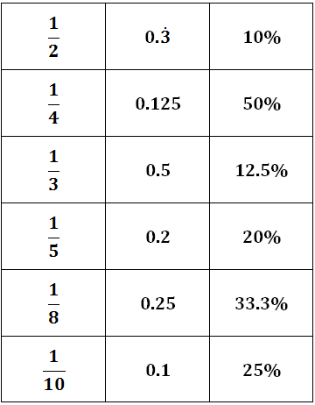
Starter
Match up the trios of equivalent fractions, decimals and percentages.

Slide 2
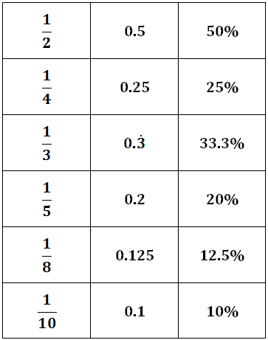
Answers
You need to know these ones off by heart!

Slide 3
Fraction
2/5
?/100
2 ÷ 5
Divide
40/100
Percentage
Decimal
40%
0.4
0.4 x 100
x 100

Slide 4
Extension: Ordering fractions, decimals and percentages

Slide 5
Answers
Fractions | Decimals | Percentages
31/100
0.31
31%
19/50
0.38
38%
7/20
0.35
35%
1/5
0.2
20%
17/25
0.68
68%
9/10
0.9
90%
13/40
0.325
32.5%
1/8
0.125
12.5%
·
·
49/60
0.816
81.6%
·
·
2/3
0.6
66.6%

Slide 6
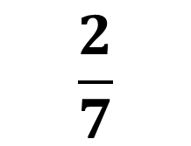
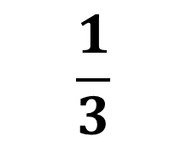
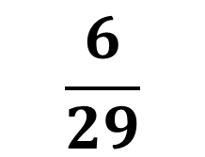
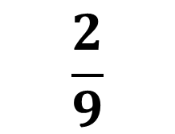
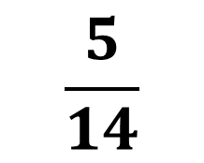
Convert these fractions to decimals:
$$\frac{1}{3}$$
$$\frac{2}{7}$$
$$\frac{5}{14}$$
$$\frac{2}{9}$$
$$\frac{6}{29}$$
0.3333333…
0.3571429…
0.2068966…
0.2857143…
0.2222222…

Slide 7
Recurring Decimals
8
Convert into a decimal using your calculator.
11
A calculator displays this as:
.
.
0.72
The digits 2 and 7 actually repeat infinitely. This is an example of a recurring decimal.
We can show this by writing dots above the 7 and the 2.
Notes:
Discuss how a calculator can be used to convert a fraction into a decimal using division.
Ask pupils to explain why the last digit has been rounded up to a 3.

Slide 8
Here are some more examples of recurring decimals:
4
.
This decimal is made up of an infinite number of repeating 4’s.
= 0.4
9
5
.
This decimal starts with an 8 and is followed by an infinite number of repeating 3’s.
= 0.83
6
2
.
.
In this decimal, the six digits 285714 repeat an infinite number of times in the same order.
= 0.285714
7
9
.
.
This decimal starts with a 4. The two digits 09 then repeat an infinite number of times.
= 0.409
22
Notes:
Explain that when a single digit repeats we put a dot above it. When a series of digits repeat we put a dot above the first number in the series and the last digit in the series.
Explain that some recurring decimals are difficult to spot because there repeating cycles are so long. For example the fraction ¹/₁₇ when converted to decimal repeats every 16 digits. Calculators don’t display numbers to this number of decimal places and so a computer (or short division) would have to be used.

Slide 9
Example
Write 0.888… as a fraction.
10x = 8.888…
Multiply by 10 because one digit is recurring
x = 0.888…
9x = 8
Subtract one from the other
x = 8
Solve
9

Slide 10
Example
Write 0.363636… as a fraction.
100x = 36.3636…
Multiply by 100 because two digits are recurring
x = 0.3636…
99x = 36
Subtract one from the other
x = 36
Solve
99
= 4
Simplify
9

Slide 11
Example
Write 0.2371371… as a fraction.
1000x = 237.1371371…
Multiply by 1000 because three digits are recurring
x = 0.2371371…
999x = 236.9
Subtract one from the other
x = 236.9
Solve
999
= 2369
Simplify
9990

Slide 12
Extension: Convert the recurring decimal 2.1363636… to a mixed number. Give your answer in its simplest form.

Slide 13
Answers
1) 5/9
2) 28/33
3) 169/999
4) 21/55
5) 163/225
6) 27/1100

Slide 14
Show me an example of:
- A fraction which terminates when written as a decimal
- A fraction which has a recurring decimal equivalent with two different digits repeating
What is the same about/different about 13/33, 44/333 and 7/40

Slide 15
True/Never/Sometimes: Fractions with a denominator which has a factor of 2 terminate when written as a decimal
Convince me that 0.417417417… = 139/333

